Slide 1
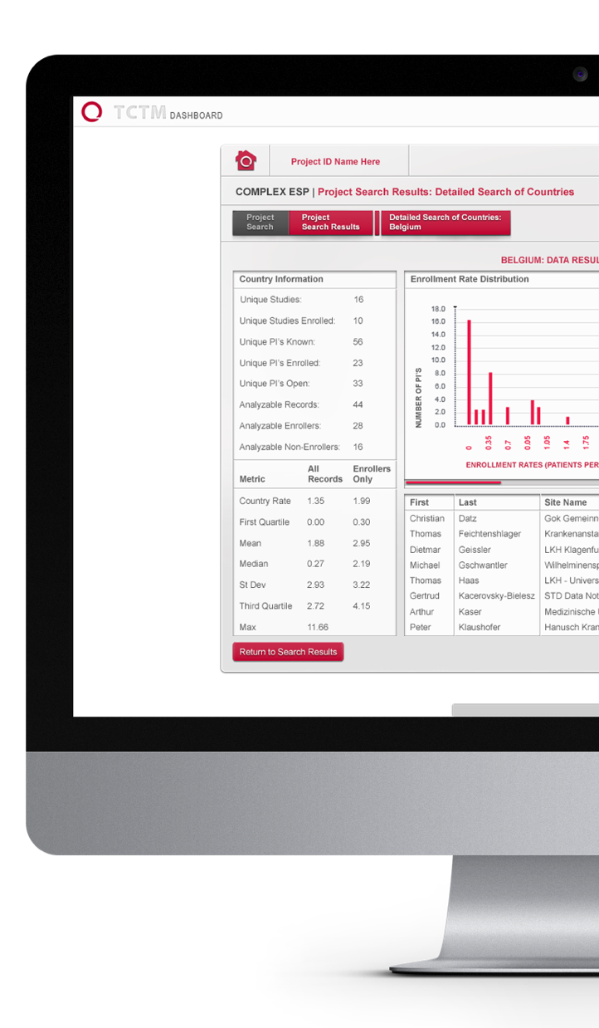
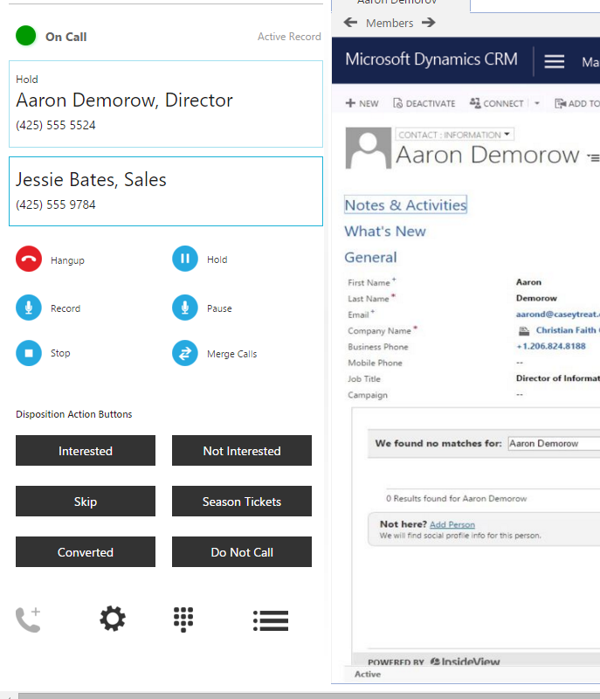
DialSource – Dynamics CRM Product Development
Business Need
DialSource produces one of the leading telephone prospecting automation tools on the Salesforce AppExchange. Their team was looking for an experienced Microsoft development partner to build out the product’s counterpart for the Microsoft Dynamics 365 platform.
What We Did Affirma partnered with DialSource to document a phased set of requirements for the product’s release stages. Our team developed the application to effectively leverage DialSource’s existing telephony infrastructure and created a great user experience within Dynamics CRM. The product has now been released to DialSource clients and is in use today. Affirma continues to work with the DialSource team on innovation and product development.

